Slide 1

Precision Pen-Plotter for Mechatronics
Team Members: Aman Patel, Vighnesh Deshmukh, Deep Shah, Rishabh Deshkar, Atharva Bhosale
University: Hochschule Schmalkalden – University of Applied Sciences
Date: July 24, 2025

Slide 2
Project Introduction & Motivation
1
2
3
Mechatronics Workshop Project
Inspired by "Nikola's House"
Hands-On Application
Selected as our Master's program centerpiece, applying theoretical knowledge to a tangible system.
Aim to recreate a complex drawing using a fully custom-built motion platform.
Practical application of control systems, mechanical design, and embedded hardware development.

Slide 3

Use Case & Core Objectives
Primary Goal: Draw Nikola's House
Key Performance Indicators
The system must accurately plot the intricate design three times in succession, demonstrating high reliability and consistency.
Precision & Repeatability: Consistent output across multiple iterations.
Emergency Stop: Immediate system halt and safe return to home position.
Safety Features: Fully enclosed electronics and controlled shutdown mechanisms to prevent hazards.

Slide 4
System Architecture Overview
The pen plotter integrates diverse components for precise motion and control, ensuring robust operation.
1
2
Central Control
Motor Control
ESP32: Chosen for its Wi-Fi capabilities and dual-core processing, ideal for real-time motor control and feedback processing.
DRV8833 & DC Motors: Dual DRV8833 drivers control two independent DC motors, enabling precise Core-XY motion.
3
4
Feedback & Safety
Pen Actuation
Optical Encoders & Limit Switches: Provide critical position feedback and boundary detection for safe and accurate operation.
Servo Motor: Controls the Z-axis (pen up/down) with high accuracy, ensuring clean lines and preventing surface damage.

Slide 5
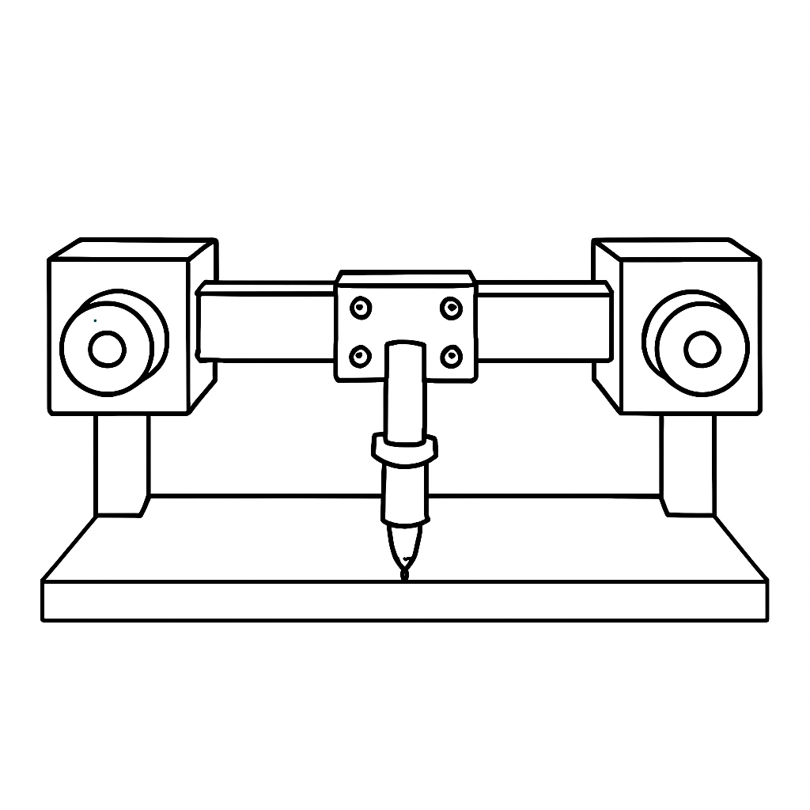
Mechanical Design & Fabrication
Every structural component of the pen plotter was custom-designed and 3D printed, emphasizing precision and modularity.
Software: Designed entirely in SolidWorks and Fusion 360, ensuring high precision and robust modeling.
Fabrication: All parts 3D printed with tight tolerances, guaranteeing accurate assembly and reliable performance.
Custom Components: Designed specific mounts for DC motors and encoders, a central carriage, pen holder with rack & pinion, and tensioners.
Emergency Stop Holder: Integrated for safety and accessibility, ensuring quick system shutdown.

Slide 6




Core-XY Kinematics
The Core-XY configuration provides efficient and precise motion, minimizing moving mass and maximizing speed.
Two Stationary Motors
Crossed GT2 Belts
Positioned at fixed points, reducing inertia and improving response time.
Interconnected system ensures synchronized movement for the X and Y axes.
Motion Decoupling
Benefits
X-axis: Motors rotate in opposite directions.
Offers high speed, simplicity in design, and precision in plotting.
Y-axis: Motors rotate in the same direction.

Slide 7

DC Motors & Synchronization Challenges
Achieving synchronized motion with standard DC motors proved more complex than anticipated.
Dual DC Motors: Used for Core-XY configuration, driving the X and Y axes.
RPM Mismatch: Even with identical PWM signals, motors exhibited varying rotational speeds, leading to cumulative errors.
Distortion Impact: Inconsistent motor speeds directly translated into distorted plotted lines, compromising drawing accuracy.
Solution Requirement: Highlighted the critical need for a fine-tuned control system to ensure perfect synchronization between the motors.

Slide 8
PID Tuning & PWM Optimization
Implementing closed-loop PID control and fine-tuning PWM parameters were crucial for mitigating RPM discrepancies and enhancing plotting accuracy.
PID Implementation
Currently integrating a Proportional-Integral-Derivative (PID) controller for real-time closed-loop correction of motor RPMs.
PWM Resolution Adjustment
Increased PWM resolution to allow for finer control over motor speeds, minimizing small velocity deviations.
PWM Frequency Optimization
Optimized PWM frequency to ensure smoother motor operation and reduce vibrations, contributing to better plotting quality.
Drawing Sequence Logic
Revised the software logic for drawing sequences, allowing for dynamic adjustments and tighter synchronization between motor commands.
Software Calibration
Developed a software calibration routine that significantly reduced the inherent RPM offset between the two DC motors.

Slide 9
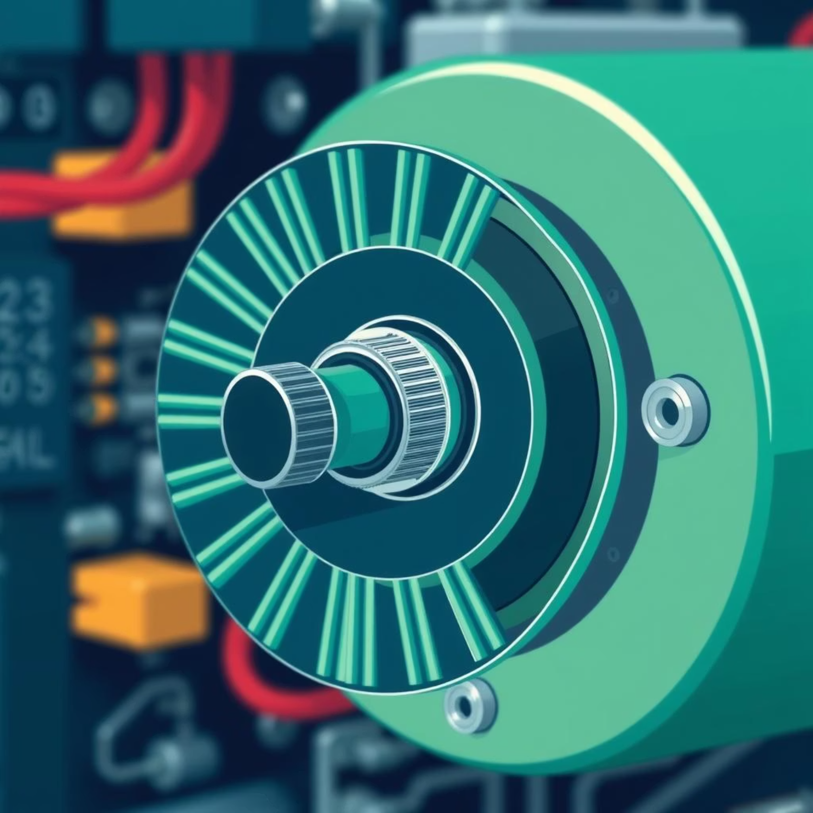
Feedback System: Optical Encoders
Optical encoders provide essential real-time feedback, forming the backbone of our closed-loop control system.
Encoder Design: Each motor is equipped with a 20-slot wheel and an optocoupler, generating pulses for rotation detection.
Purpose: Provides critical RPM and angular position feedback to the ESP32, enabling precise motor synchronization and path tracking.
Closed-Loop Control: Essential for achieving the required accuracy in X and Y axis movements, correcting for motor inconsistencies.
Future Enhancement: Quadrature Encoders: Planned upgrade to improve resolution and provide directional information for enhanced precision.
Future Enhancement: Hall Effect Sensor: To be integrated for reliable paper presence detection, preventing plotting errors on empty surfaces.

Slide 10




Z-Axis: Precise Pen Control
The Z-axis mechanism ensures consistent pen contact and clean, repeatable lines.
Servo Motor Actuation
Rack & Pinion Mechanism
A dedicated servo motor provides fine angular control for precise pen up/down movements.
Integrated directly into the pen holder, translating rotational servo motion into linear vertical movement of the pen.
Optimal Pen Contact
Repeatability
Ensures consistent pressure on the drawing surface, preventing skips while avoiding damage.
The mechanical design guarantees highly repeatable pen lifts and drops, critical for multi-pass drawings.

Slide 11

Precision Plotting: Overcoming GT2 Belt Challenges
This presentation details the mechanical and software innovations in our custom CNC plotter, focusing on precision, safety, and future upgrades.

Slide 12
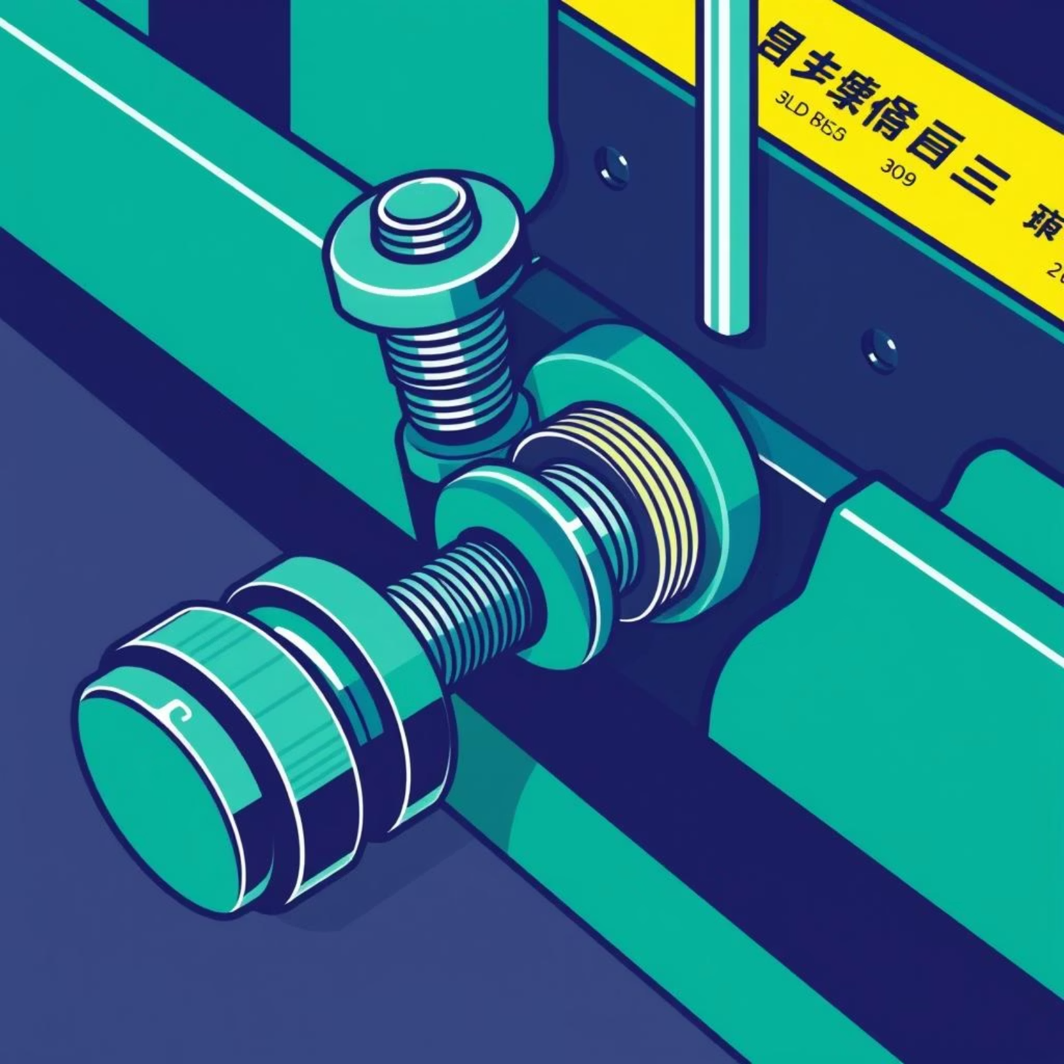
Custom Tensioner Design
Initial runs revealed GT2 belt loosening, causing plot inaccuracies. We designed adjustable 3D-printed tensioners, allowing precise manual tightening to eliminate slack and ensure consistent belt tension. This significantly improved stability and accuracy.

Slide 13


Limit Switches & Homing Logic
Dual Limit Switch Installation
Firmware Homing Function
Two mechanical limit switches were integrated: one at the left-front mount and another at the belt tensioner base. These provide precise physical boundaries for the plotter's movement.
A homing function was implemented in the ESP32 firmware. Upon power-up or command, the plotter automatically moves to a defined reference position, ensuring a consistent and accurate starting point for all operations.

Slide 14



Emergency Stop & Resume
Immediate Motion Halt
Position Saved to EEPROM
Homing & Resume
After a reset, the machine first returns to its homing position, then recovers and resumes plotting from the exact point of interruption, ensuring seamless operation.
The emergency stop feature instantly halts all plotter motion, preventing damage or injury in critical situations.
The plotter's current position is automatically saved to non-volatile EEPROM memory upon activation of the emergency stop.

Slide 15




Path Planning Logic
The plotter's path planning was custom-coded to accurately reproduce complex designs without relying on G-code in the initial phase.
Nikola’s House Segmented
Sequential Path Encoding
The drawing of Nikola’s House was meticulously broken down into individual line segments for precise control.
Each line segment's coordinates and drawing instructions were explicitly coded in sequence, dictating the plotter's movement.
Triple Loop Execution
Axis Synchronization Focus
The entire path was executed in a loop function, repeating three times to verify consistency and achieve the desired final output.
Critical attention was paid to ensuring perfect synchronization between all axes, vital for accurate and repeatable drawings.

Slide 16
Testing & Debugging
During development, several key issues were identified and systematically addressed:
A comprehensive suite of tools was utilized to diagnose and resolve these challenges:
Loop closure inconsistencies
Multimeter for circuit diagnostics
Suboptimal belt alignment
Serial monitor for real-time data inspection
Motor synchronization drift
Encoder monitoring for position feedback
Encoder wiring noise interference
Solutions involved stepwise testing, CAD model correction, and meticulous firmware tuning.
Intermittent circuit disconnects

Slide 17
Final Output – Nikola’s House
After extensive testing and fine-tuning, the plotter successfully rendered Nikola’s House three consecutive times without any noticeable drift or deviation. This achievement confirms the precision enhancements gained through mechanical adjustments and firmware optimization.

Slide 18
Future Scope & Upgrades
Precision Feedback
Implement 2-channel quadrature encoders for enhanced positional accuracy and real-time feedback control.
G-code Compatibility
Integrate G-code parsing functionality, enabling compatibility with Inkscape and other CAD/CAM software for diverse design inputs.
Dedicated Controller
Utilize a secondary ESP32 as a dedicated parsing controller, offloading processing from the main MCU and improving efficiency.
Wireless Interface
Develop an optional Wi-Fi or Bluetooth user interface for remote commands and real-time monitoring of plotter operations.
Motor Upgrade
Transition to high-precision stepper motors for ultra-high resolution and smoother motion, catering to advanced plotting needs.

Slide 19
Conclusion & Learnings
Developed Strong Skills In:
Learned Importance Of:
Mechatronics integration
Robust feedback control systems
Embedded coding (ESP32)
Modular mechanical design principles
CAD & 3D printing
System safety & recovery handling
Real-time debugging

Slide 20

Thank You / Q&A
Thank you for your attention and interest in our CNC plotter project. We are now open for any questions or feedback you may have.

